Slide 1
Project – Cloud Solution Framework for a Medical Startup Company
Group No.6:
Anmol Atmaram Desai
Quoc Tuong Dong
Yashmi Shirish Sevak

Slide 2
Agenda
1/ Introduction
2/ Executive Summary
3/ Current Architecture
4/ Requirements
5/ AWS Services
6/ Proposed Architecture
7/ Network and Security
8/ Scalability, HA,, Business Continuity
9/ Monitoring and Auditing
10/ Next Steps and Conclusion

Slide 3
Introduction
Our Client is a medical startup SaaS company that has built an online medical social networking and diagnosis assistances application for APAC, US and Europe:
Connect Patients and Doctors
Customers can schedule online appointments/consultation/ diagnosis, electric prescription transfer and payment services
Customers can upload documents and have text extracted to store in database
Contains PII data and need HIPPA compliance
Always available with no down time

Slide 4

Executive Summary
Current Architecture:
The current system is hosted on premises with the web and application server on Microsoft Windows platform with IIS while the database is running on Microsoft Server Standard Edition.
Proposed solution:
Out of three current popular Cloud platform, AWS is the most suitable choice for our requirements that allows us to secure our data and expand the business internationally
Design
Designing a scalable and more secure system for the 3-tier architecture which can be accessible to all three regions.
Providing privilege rights to employees depending on there functional groups and assign them to dedicated AWS service.
Benefits
Write Infrastructure as code, scale identical solution.
Cheap solution and you pay for what you use.
Innovate faster, reduced time to market.
Globally accessible with no drop times.

Slide 5
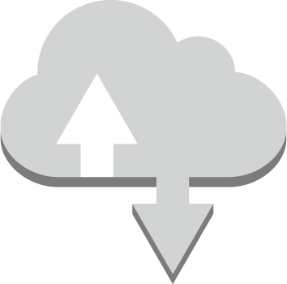
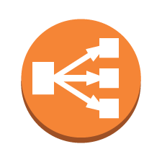

Medical Company’s Current Environment
The medical startup is using Microsoft Windows servers to host their web and application tiers with Microsoft SQL Server Standard Edition backend databases.
Web Tier:
Two physical servers (2 CPUs / 4-GB memory)
Application Tier:
Two physical servers (4 CPUs / 16-GB memory)
Database Tier:
One physical server (8 CPUs / 32-GB memory / 5-TB storage)
Web Tier –
2 CPUs,
4-GB memory,
MS Windows
Web Tier –
2 CPUs,
4-GB memory,
MS Windows
App Tier –
4 CPUs,
16-GB memory,
MS Windows
App Tier –
4 CPUs,
16-GB memory,
MS Windows
Database Tier –
8 CPUs, 32-GB memory, 5-TB storage,
MS Windows, SQL Server SE
Notes:
For your preparations, the customer provided this diagram of their current architecture.
The current architecture has three tiers: a web tier, a database tier, and an application tier. They are configured as follows:
Web Tier
Two physical servers (Two CPUs / 4-GB memory)
Microsoft Windows 2016 Base with Internet Information Services (IIS)
High Availability Proxy load balancer used to balance traffic between the web servers
Application Tier
Two physical servers (Four CPUs / 16-GB memory)
Microsoft Windows 2016 Base with Internet Information Services (IIS)
High Availability Proxy load balancer used to balance traffic between app servers
Database Tier
One physical server (Eight CPUs / 32-GB memory / 5-TB storage)
SQL Server Standard Edition with Microsoft Windows 2016 Base
DBAs access and manage the database, but no RDMBS or advanced configuration is required.

Slide 6
Overall Requirements and Assumptions
Access permissions to the authorized users based on their roles
Providing network connectivity to the applications in various environments.
Constructing good architecture capable of autoscaling and handling crisis
Adding monitoring services, protection to customers data and be HIPPA compliant
Load Balancing across application and web tier
Extracting documents from images

Slide 7
Solution – Identify AWS Services
Auto-scaling : Automatically add or remove capacity based on demand
AWS Lambda: serverless compute service that lets you run code without provisioning or managing servers
CloudFront: Content delivery networks provide a globally-distributed network of proxy servers that cache content, such as web videos or other bulky media, more locally to consumers
CloudTrail: To track user activity
CloudWatch: a monitoring and observability service built for DevOps engineers, developers, site reliability engineers (SREs), and IT managers
EC2: offers secure, and resizable compute capacity. Enable easy access and usability to developers for web-scale cloud computing, deploy applications rapidly without the need for investing in hardware upfront
Elastic Beanstalk: Automatically manage the deployment; from capacity tuning, load balancing, auto-scaling, to application health evaluation and monitoring.
AWS Cognito: Manage Identity inside application
AWS Web App Firewall: To protect against web attacks and to improve web traffic visibility.
AWS firewall Manager: For centrally managing firewall rules
AWS DMS: Migrating data from relation Db and Datawarehouse to cloud with minimum fuss or change to schemas
Elastic Block Store (EBS): high-performance block storage solution. Handles a diverse range of workloads
IAM: provides secure access and management of resources in a secure and compliant manner.
Notes:
Let’s make a list of potential services and the why it was selected. For example, we know that we need to manage user access and we would use IAM to do that.

Slide 8
NAT gateway: connect instances in a private subnet to services outside your VPC but external services cannot initiate a connection with those instances.
RDS: makes database configuration, management, and scaling easy in the cloud. Automate tedious tasks
Route 53: connects user requests to infrastructure running in AWS (EC2 instances, Elastic Load Balancing load balancers, S3 buckets – and can also be used to route users to infrastructure outside of AWS
S3 :facilitates object storage, providing leading scalability, data availability, security, and performance.
VPC: set up a reasonably isolated section of the AWS Cloud where you can deploy AWS resources at scale in a virtual environment. Total control over your environment
Amazon Macie: To discover and protect sensitive data
Secret Manager: For automatic password change
AWS Backup: For scheduled Backup
HealthLake: It is a HIPAA-eligible service that enables healthcare providers, health insurance companies, and pharmaceutical companies to store, transform, query, and analyze health data at scale.
AWS Sagemaker: Used by Developers/Data Scientists to build machine learning models
QuickSight: QuickSight lets you easily create and publish interactive BI dashboards that include Machine Learning-powered insights
Personal HealthDashboard: The dashboard displays relevant and timely information to help you manage events in progress, and provides proactive notification to help you plan for scheduled activities
Notes:
Let’s make a list of potential services and the why it was selected. For example, we know that we need to manage user access and we would use IAM to do that.

Slide 9
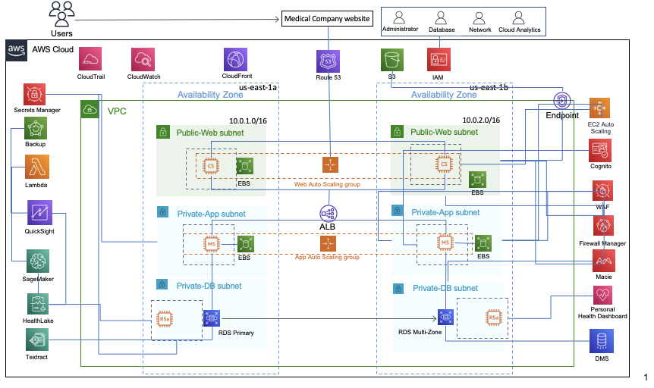
Solution – Proposed Architecture

Slide 10
Solution – User Authentication
Medical Company Account
System Administrator
Database Administrator
Monitoring/Auditing Group
Role: IAM
System Admin
Database administrator I
Database
Database
Network Admin
Database administrator II
Network Security
Cloud Analytics
Cloud Security
Notes:
Use this chart to document users, groups, and roles that need to be created.

Slide 11
Group/Role # | Group/Role Name | Permissions
System Administrator | System/Network Admin | Read/Write - All Services
Database Administrator | Database administrator- 1, Database administrator- 2 | Read – EC2 & Read/Write - CloudWatch, RDS, S3, DMS, EBS, Redshift, Backup
Monitoring/ Auditing Group | Database, Network Security | Read/Write - EC2, AWS Cognito, AWS Web App Firewall, AWS Firewall Manager, CloudWatch, CloudTrail, NAT Gateway, Route 53, VPC, AWS Secret Manager
Role | Database | EC2 & Read/Write - CloudWatch, RDS, S3, DMS, EBS, Redshift, Backup.
Role | Cloud Analytics | Read/Write - AWS HealthLake, AWS SageMaker, AWS QuickSight, AWS Personal Health Dashboard
Role | Cloud Security | Read/Write- AWS Web App Firewall, AWS Firewall Manager, CloudWatch, CloudTrail, NAT Gateway, Route 53, VPC, AWS Secret Manager.
Notes:
Use this chart to document the groups and their associated permissions.

Slide 12
Solution – Network and Security
VPC | Region | Purpose | Subnets | AZs | CIDR Range
1 | Us-east-1 | Deployment | 2 | 1 | 10.0.1.0/16
1 | Us-east-1 | Disaster Recovery | 1 | 1 | 10.0.2.0/16
1 | Us-east-1 | Development and Testing | 1 | 1 | 10.0.3.0/16
1 | Us-west-1 | Deployment | 2 | 1 | 10.0.4.0/16
1 | Us-west-1 | Disaster Recovery | 1 | 1 | 10.0.5.0/16
1 | ap-south-1 | Deployment | 2 | 1 | 10.0.6.0/16
1 | ap-south-1 | Disaster Recovery | 1 | 1 | 10.0.7.0/16
1 | ap-northeast-1 | Deployment | 2 | 1 | 10.0.8.0/16
1 | ap-northeast-1 | Disaster Recovery | 1 | 1 | 10.0.9.0/16
1 | ap-southeast-2 | Deployment | 2 | 1 | 10.0.10.0/16
1 | ap-southeast-2 | Disaster Recovery | 1 | 1 | 10.0.11.0/16
1 | eu-central-1 | Deployment | 1 | 1 | 10.0.12.0/16
1 | eu-central-1 | Disaster Recovery | 1 | 1 | 10.0.13.0/16
1 | eu-west-1 | Deployment | 1 | 1 | 10.0.14.0/16

Slide 13
Subnet Name | VPC | Subnet Type (Public/private) | AZ | Subnet Address
US Region
Public-web subnet1 | #1 | Public | us-east-1a | 10.0.1.0/16
Private-App subnet2 | #1 | Private | Us-east-1a | 10.0.2.0/16
Private-DB subnet3 | #1 | Private | Us-east-1a | 10.0.3.0/16
Public-web subnet1 | #1 | Public | Us-west-1a | 10.0.4.0/16
Private-App subnet2 | #1 | Private | Us-west-1a | 10.0.5.0/16
Private-DB subnet3 | #1 | Private | Us-west-1a | 10.0.6.0/16
APAC Region
Public-web subnet1 | #1 | Public | ap-south-1a | 10.0.7.0/16
Private-App subnet2 | #1 | Private | ap-south-1a | 10.0.8.0/16
Private-DB subnet3 | #1 | Private | ap-south-1a | 10.0.9.0/16
Public-web subnet1 | #1 | Public | ap-northeast-1a | 10.0.10.0/16
Private-App subnet2 | #1 | Private | ap-northeast-1a | 10.0.11.0/16
Private-DB subnet3 | #1 | Private | ap-northeast-1a | 10.0.12.0/16
Public-web subnet1 | #1 | Public | ap-southeast-2a | 10.0.13.0/16
Private-App subnet2 | #1 | Private | ap-southeast-2a | 10.0.14.0/16
Private-DB subnet3 | #1 | Private | ap-southeast-2a | 10.0.15.0/16
Notes:
Use this chart to document the Production subnet solution.

Slide 14
Subnet Name | VPC | Subnet Type (Public/private) | AZ | Subnet Address
EU Region
Public-web subnet1 | #1 | Public | eu-central-1a | 10.0.16.0/16
Private-App subnet2 | #1 | Private | eu-central-1a | 10.0.17.0/16
Private-DB subnet3 | #1 | Private | eu-central-1a | 10.0.18.0/16
Public-web subnet1 | #1 | Public | eu-west-1a | 10.0.19.0/16
Private-App subnet2 | #1 | Private | eu-west-1a | 10.0.20.0/16
Private-DB subnet3 | #1 | Private | eu-west-1a | 10.0.21.0/16
Notes:
Use this chart to document the Production subnet solution.

Slide 15
Solution – Web and Application Tier
Description of the type, size, and justification for the instances
Tier | Tag* | OS | Type | Size | Justification | # of instances | User Data?
Web | Key = Name Value = web-tier | Microsoft Windows Server 2019 | c5.large | 2 CPUs, 4GB Memory | Compute optimised instance- To handle website traffic | 2-4 | Yes
App | Key = Name Value = app-tier | Microsoft Windows Server 2019 | m5.xlarge | 4 CPUs, 16GB Memory | General Purpose workloads- Application servers | 2-4 | Yes
DB | Key = Name Value = db-tier | N/A | r5a.2xlarge | 8 CPUs, 64GB Memory | Memory intensive workloads- To handle high level DBs | 1 Master and 1 Standby | Not applicable
* Tags must be configured as shown to meet the lab objectives

Slide 16
Solution – Web and Application Tier
Load Balancer and instance security details
Load Balancer | Name* | External/Internal | Subnets | SG Name* | Rule | Source
For Web Tier | web-elb | External | Public Subnet | web-elb-sg | Port 443 | 0.0.0.0/0
For App Tier | app-elb | Internal | Private Subnet | app-elb-sg | Port 443 | Private Subnet IP as per different regions
Instance Tier | SG Name* | Rule | Source
Web Tier | web-tier-sg | Port 443 (web browsing port, is primarily used for HTTPS services) | ALB
App Tier | app-tier-sg | Port 443 | ALB
Database Tier | db-tier-sg | Port 1443 (Aurora/MySQL/MariaDB) | App Security Group
* Names must be configured as shown to meet the lab objectives

Slide 17
Solution- Detailed Requirements/ Business Continuity
Tier | OS | Type | Size | Configuration Name* | Subnets | Security Group
Web | Microsoft Windows Server 2019 | c5.large | 2 CPUs, 4GB Memory | WebTier | 10.0.2.0/16 10.0.5.0/16 | web-elb-sg
App | Microsoft Windows Server 2019 | m5a.xlarge | 4 CPUs, 16GB Memory | AppTier | 10.0.3.0/16 10.0.4.0/16 | app-elb-sg
* Names must be configured as shown to meet the lab objectives
Notes:
When configuring Auto Scaling groups, follow the same instance types as the ones previously configured.

Slide 18
Solution- Monitoring and Auditing
Auditing
CloudTrail- continuously monitor, and retain account activity related to actions across your AWS infrastructure
Various Events used to record activities-
Data events
Management events
CloudTrail insights
Monitoring
CloudTrail integration with CloudWatch Logs delivers management and data events captured by CloudTrail to a CloudWatch Logs log stream in the CloudWatch Logs log group you specify.
By default, CloudTrail logs are aggregated per region and then redirected to an S3 bucket. We can then use the recorded logs to analyse calls and take action accordingly.
Shipping these logs into the AWS Elasticsearch and then Kibana dashboard will allow to tackle this challenge by the ability to easily aggregate, analyse and visualize the data.
Notes:
To ensure that the architecture can handle doubling the number of servers to support its rapid growth, set the minimum capacity to 2 and the maximum capacity to 4.

Slide 19
Next Steps and Conclusion
Conclusion
For this medical company we have created a AWS cloud architecture considering all 3 tiers that is Web, Application and Database to provide better scalability, security and flexibility.
Using Machine Learning Services we have created a flexible environment to create and access the data dashboard.
Cost Optimized solution.
No server down time due to more than one AZ.
Next Steps
Migrating data from the company's Microsoft SQL server to AWS RDS Using AWS DMS
Hosting website on AWS server
Automating the system by configuring AWS lambda for machine learning using AWS Sage maker

